Slide 1
NLP

Slide 2
Introduction to NLP
Logistic Regression

Slide 3
Combining Features
Linear interpolation for language modeling
Estimating the trigram probability P(c|ab)?
features: P_{MLE}(c|a), P_{MLE}(c), etc.
Weights: λ₁, λ₂, etc.
We may want to consider other features
E.g., POS tags of previous words, heads, word endings, etc.
General idea
Compute the conditional probability P(y|x)
P(y|x) = sum of weights*features
Label Y for a given history x in X

Slide 4
Logistic Regression
Similar to Naïve Bayes (but discriminative!)
Log-linear model
Features don’t have to be independent
Examples of features
Anything of use
Linguistic and non-linguistic
Count of “good”
Count of “not good”
Sentence length

Slide 5
Feature Templates
For each word $w
$w_count
$w_ends_in_er
$w_is_negated
$w_is_all_caps

Slide 6
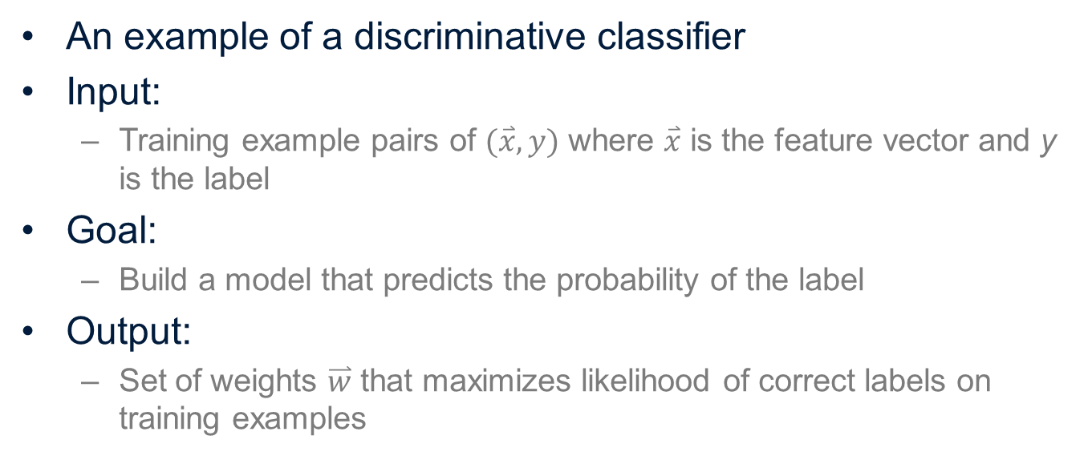
Logistic Regression
An example of a discriminative classifier
Input:
Training example pairs of $(\overset{⃑}{x}, y)$ where $\overset{⃑}{x}$ is the feature vector and y is the label
Goal:
Build a model that predicts the probability of the label
Output:
Set of weights $\overset{⃑}{w}$ that maximizes likelihood of correct labels on training examples

Slide 7
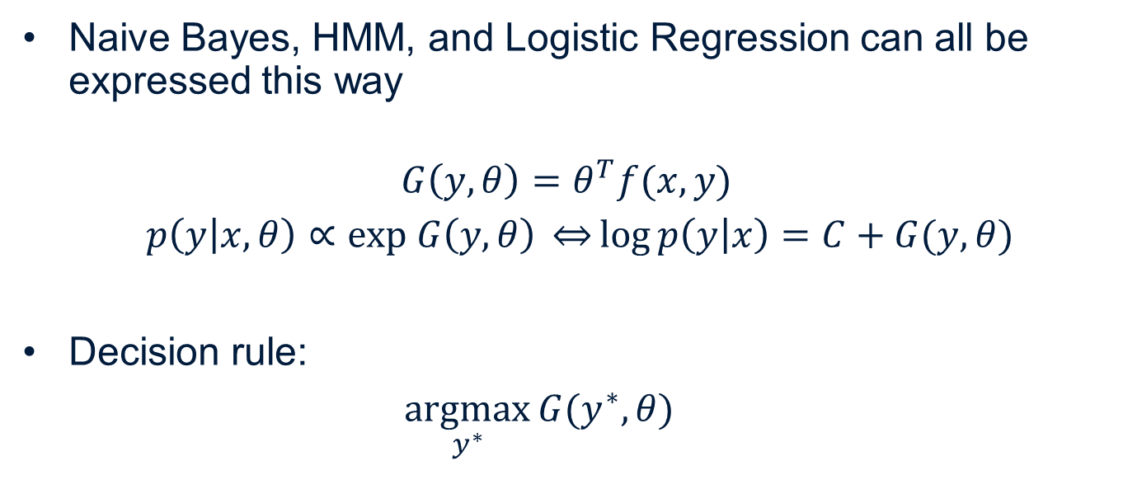
Loglinear Models
Naive Bayes, HMM, and Logistic Regression can all be expressed this way
$$G\left(y,θ\right)=θ^{T}f(x,y)$$
$p\left(y | x,θ\right)∝exp G\left(y,θ\right) \overset{⇔}{}\log{p\left(y | x\right)}=C+G(y,θ)$
Decision rule:
$\underset{y^{∗}}{argmax}{G(y^{∗},θ) }$

Slide 8
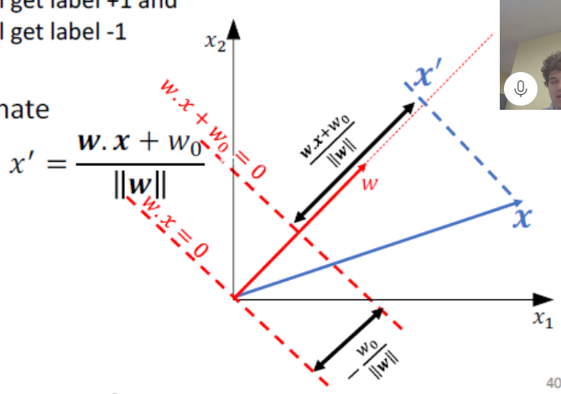
Mapping x to a 1-D coordinate
[image from Greg Shakhnarovich]

Slide 9
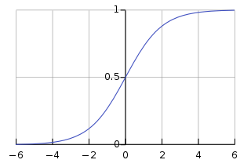

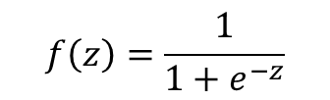
Including a Nonlinearity
Compute the feature vector x
Multiply with weight vector w
Compute the logistic function (sigmoid)
$$z=\sum{w_{i}x_{i}}$$
$$f\left(z\right)=\frac{1}{1+e^{−z}}$$

Slide 10
Examples
Example 1
x = (2,1,1,1)
w = (1,-1,-2,3)
z = 2-1-2+3=2
f(z) = 1/(1+e⁻²)
Example 2
x = (2,1,0,1)
w = (0,0,-3,0)
z = 0
f(z) = 1/(1+e⁰) = 1/2

Slide 11
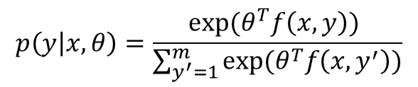


Softmax
Recall
Is this a valid probability distribution?
Yes, using softmax
$$p\left(y | x,θ\right)∝exp⁡(θ^{T}f\left(x,y\right))$$
$$p\left(y | x,θ\right)=\frac{exp⁡(θ^{T}f\left(x,y\right)) }{\sum_{y^{′}=1}^{m}{exp⁡(θ^{T}f\left(x,y^{′}\right))}}$$
$$p\left(y | x,θ\right)={softmax}_{y}(θ^{T}f\left(x,y\right))$$

Slide 12
NLP

